Slide 1
.
General Assembly 2017
The General Trustees

Slide 2
The Church of Scotland General Trustees

Slide 3
The Church of Scotland General Trustees

Slide 4
The Church of Scotland General Trustees

Slide 5
The Church of Scotland General Trustees

Slide 6
The Church of Scotland General Trustees
2016
Loans totalling £4,500,000
Standard Grants £902,000
Priority Grants £1,052,000
TOTAL £6,454,000

Slide 7
The Church of Scotland General Trustees
DECISION MAKING.
Presbyteries decide which churches are required.
Emotional as well as logical challenge.
GTs wish to work more closely with Presbyteries.

Slide 8
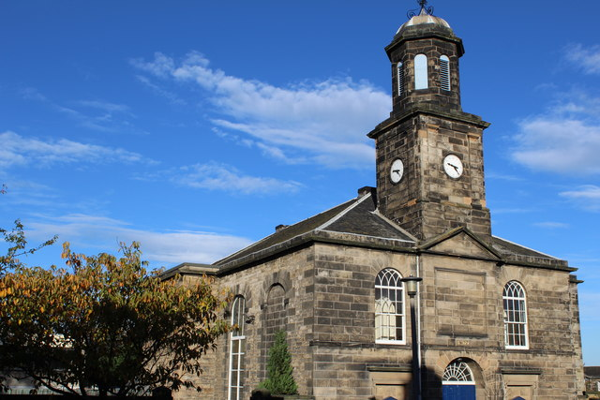
The Church of Scotland General Trustees
Portobello Old

Slide 9
The Church of Scotland General Trustees
Working Groups

Slide 10
Church of Scotland General Trustees
IMPROVED RETURNS from GLEBES.
Compare income from rental with potential income from investment of capital value.

Slide 11
The Church of Scotland General Trustees
HEALTH and SAFETY TOOLKIT
Help is at hand!

Slide 12
The Church of Scotland General Trustees

Slide 13
The Church of Scotland General Trustees
QUINQUENNIAL SURVEYS.
Quinquennial Building Surveys are critically important.
Surveyor should present findings to Boards/Kirk Session.
Fabric Committee must take action to address the matters raised.

Slide 14
The Church of Scotland General Trustees

Slide 15
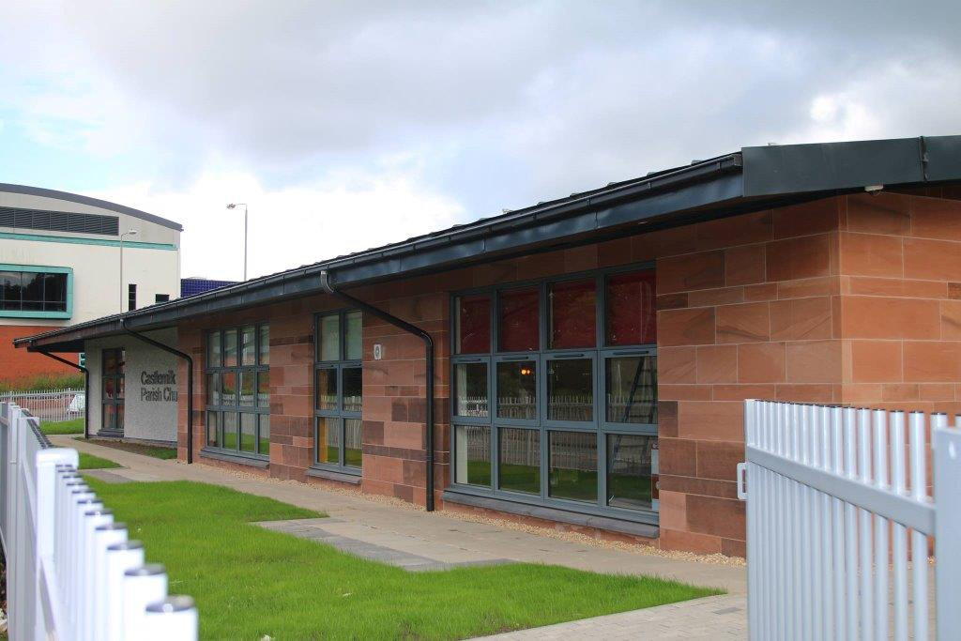
The Church of Scotland General Trustees
Castlemilk Parish Church

Slide 16
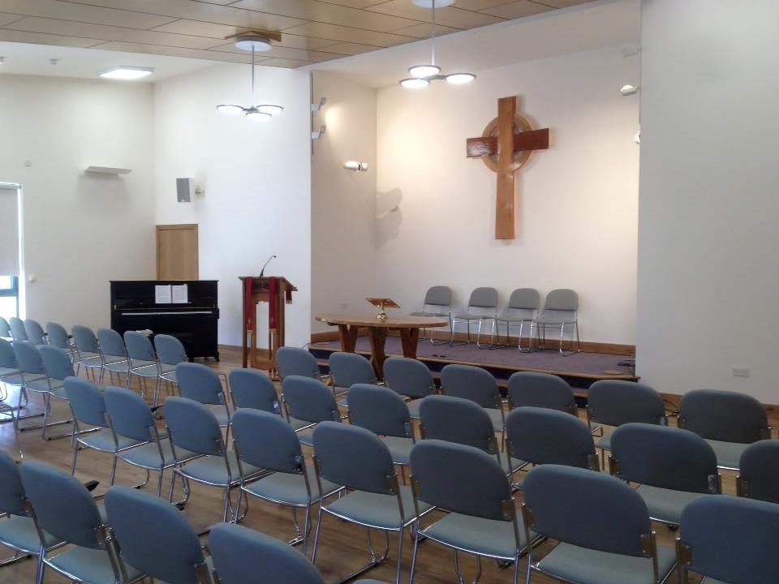
The Church of Scotland General Trustees
Castlemilk Parish Church

Slide 17
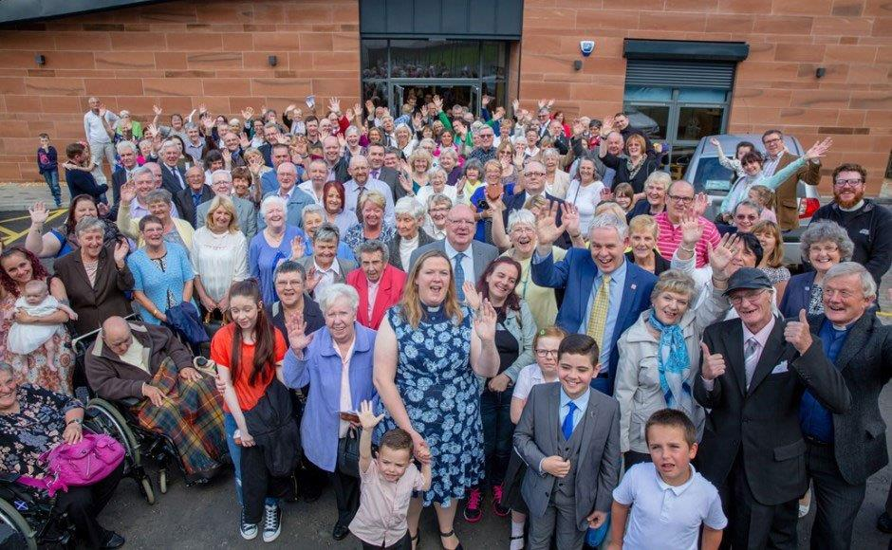
The Church of Scotland General Trustees
Castlemilk Glasgow

