Slide 1

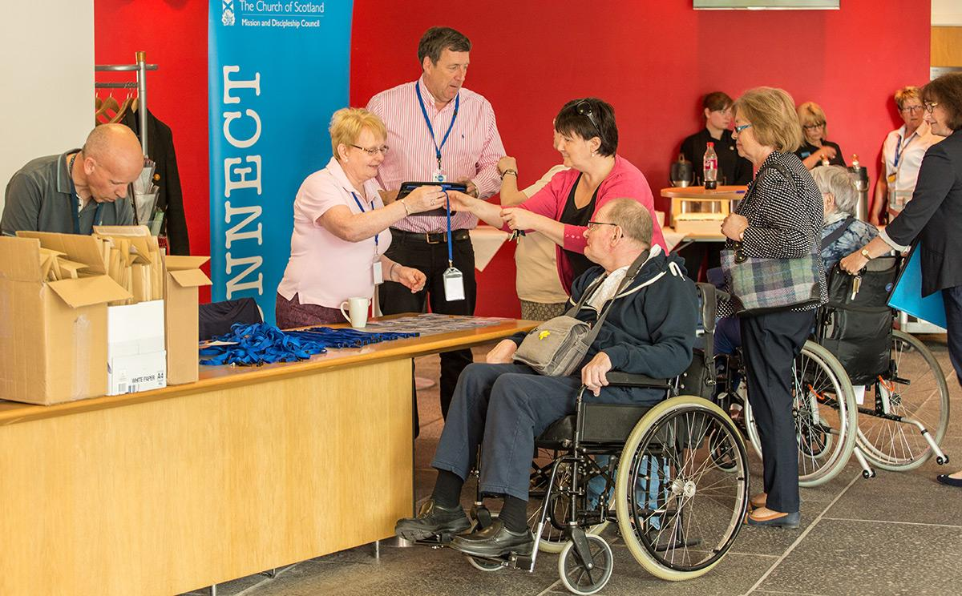
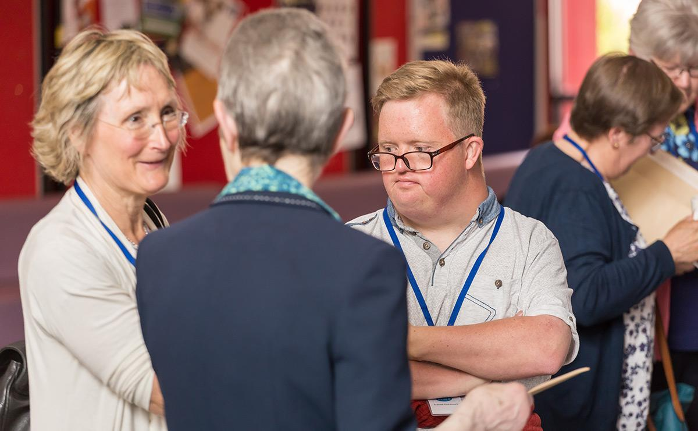
Learning Disabilities -
Making worship more inclusive

Slide 2
For just as we have many members in one body and all the members do not have the same function, so we, who are many, are one body in christ, and individually members one of another.
Romans 12. 4-5

Slide 3
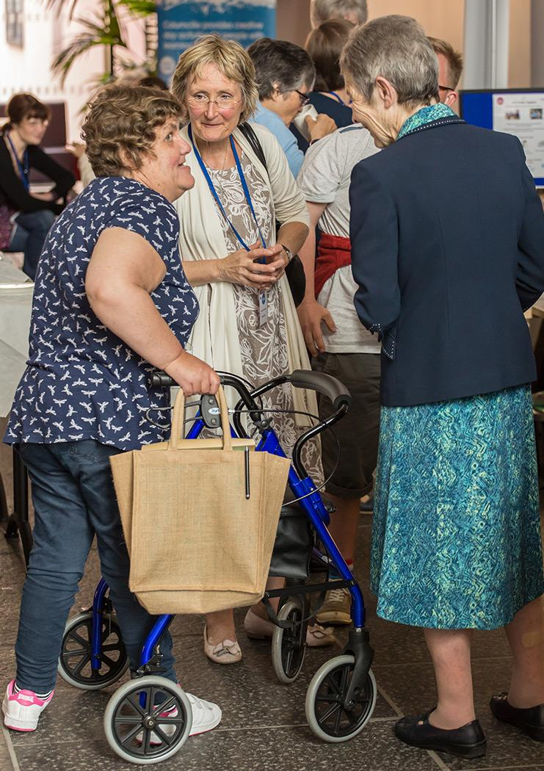
What is a learning disability?
Someone with a learning disability has a reduced intellectual ability and encounters difficulty with everyday activities – for example household tasks, socialising or managing money – which affects someone for their whole life.
People with a learning disability tend to take longer to learn and may need support to develop new skills, understand complicated information and interact with other people.
The level of support someone needs depends on the individual. For example, someone with a mild learning disability may only need support with things like getting a job.
However, someone with a severe or profound learning disability may need full time care and support with every aspect of their life. They may also have physical disabilities.

Slide 4
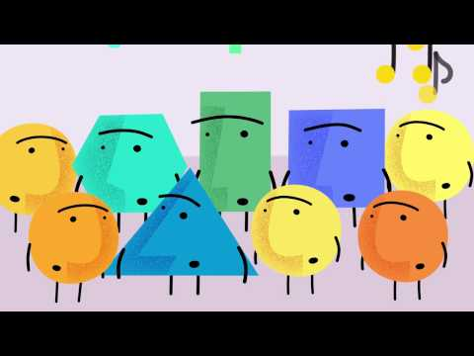
Learning disabilities in the Church
Examples of learning disabilities
Down’s Syndrome
Williams Syndrome
Global Development Delay
Cerebral Palsy
Dyslexia, Dysgraphia, Dyscalculia
Auditory Processing Disorder
Language Processing Disorder

Slide 5
David’s Story
David carries the bible & communion bread
“My Godson David loves Church. He feels at home in the Church – surrounded by familiar faces and family friends. Every Sunday service in the Parish Church, David carries the bible into the sanctuary. It means a lot to him to do that – to have a position of honour. He knows why it is a key job and what it means.
“When you first meet David he can be quite quiet, but he speaks in other ways. He is a prizewinning photographer. Last year David and I went to an academic conference entitled Exploring the Glory of God, where David presented a slideshow of his photos.
“David’s presentation, together with the communion afterwards, where David distributed bread, opened delegates’ eyes through the silent language of photographs and the sacrament, to the glory of God that is revealed when the people of God seek to include all.”

Slide 6
How many people in your Parish have a learning disability?

Slide 7
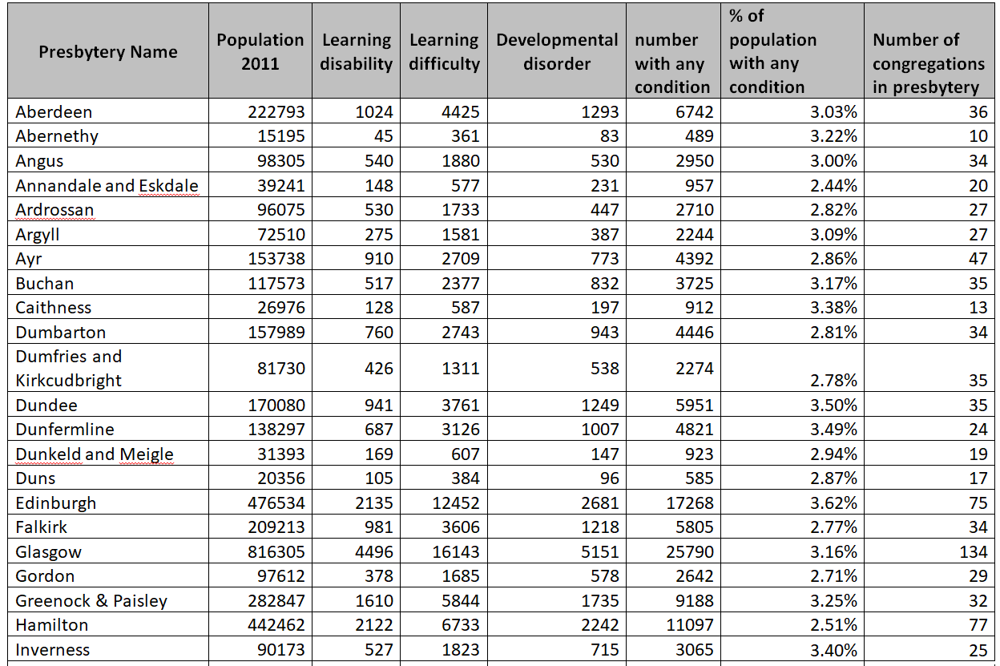
Fact Finding
What percentage of your presbytery population are registered with a learning disability, difficulty or developmental disorder? Does this surprise you?
Is your congregation proportionally representative? Does this lead you to any conclusions or action points?

Slide 8
People with learning disabilities in your Community
These questions may require having conversations with people in your congregation and you might not be able to answer them right now.
Feel free to make a note of each question and answer them in your own time.
Who in your congregation has additional needs?
What are their needs (that you know of)?
How have you shaped the Church experience to fit them? Is there more you could do?
Learning Disability Contact
Does your congregation/presbytery have a registered Learning Disability Contact?
A Learning Disability Contact is someone in the congregation who has signed up to receive information and resources from the Church of Scotland about learning disabilities and communities of belonging.
Get in touch with your session clerk to find out whether your congregation has a Learning Disability Contact.

Slide 9
Should we adapt our main church service or create a ‘parallel expression’ service for people with learning disabilities?

Slide 10
Adapting the main service
Although working alongside the church allows you to tailor your approach to best suit people’s needs there are also great benefits to looking at your main expression of worship and seeing if it could be adapted.
We have heard people say that changes they made in their Sunday services to help those with learning disabilities have actually ended up benefiting everyone.
Here are some examples of what other churches have done.
Shorten the sermon
Use symbols alongside headings in the order of service
Change font colour on overhead
Use simpler songs and incorporate actions
Provide percussion instruments
Use larger print
Set jobs for those with learning disabilities to help them feel valued
e.g. carrying in the Bible
Send notices out by email the day before
Use a simple Bible translation

Slide 11
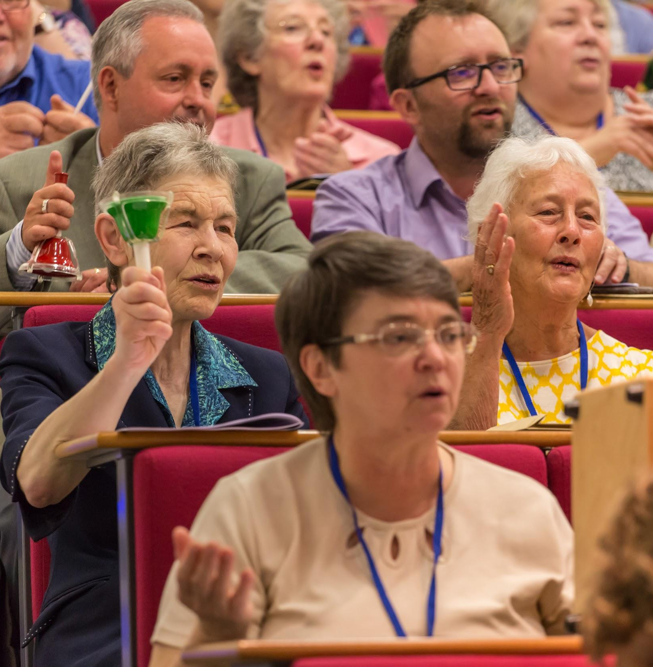
What is parallel expression?
This is a group that meets at a time other than the main Sunday morning service. Sometimes these groups can function like a house group. There is often a time of singing, a small time of reflection or teaching, a fun activity and refreshments.
These groups don’t have to be just for those with learning disabilities – the fun can be experienced by all. Parallel expressions can be built to meet the needs and likes of those that attend, and they can also be great places for people who don’t usually attend church or people from across denominations – all faiths and none!
You can build your group around what your volunteer team can manage. It doesn’t have to be a weekly meeting, it could be fortnightly, monthly or even quarterly. If you have a church or a church hall that is accessible and appropriate you could use that but you could also rent a different space.

Slide 12
Discussion
What are the strengths and weaknesses of choosing an expression of worship that runs alongside the main church worship?
Strengths
Weaknesses
It allows us to tailor our session to meet the needs of those with learning disabilities rather than trying to please everyone
There are lots of free resources available to help us run sessions like this.
I think that this would be an easier route than trying to change the main service – lots of people might resist change.
Having integrated services allows the body of Christ to worship together.
Lots of congregations feel they gain so much by worshipping with those with Learning Disabilities.
We would have to find a space to hold the event in.

Slide 13
Discussion
If you were to start a new expression of church, what new opportunities would this open to you? Are there any risks with a venture like this?
Opportunities
Threats
It allows us to reach out to others with learning disabilities and their companions – they would feel more comfortable coming along to something like this.
Lots of other people might enjoy this interactive and informal style of gathering.
This would be a good way to link with the community.
By making these two groups separate we could be giving the wrong message.
We are not meant to separate out but adjust and learn to worship together.
Would we be able to find a new pool of volunteers and have the time and resource to train them?

Slide 14
If you were to design a new type of service from a completely blank canvas
- what would it look like?

Slide 15
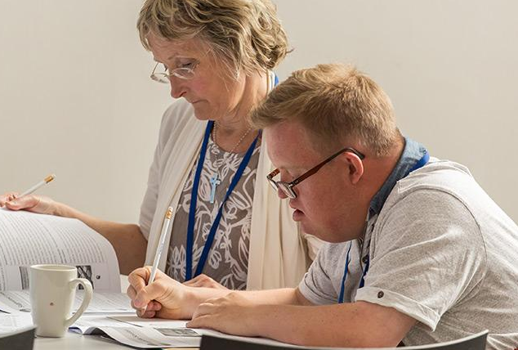
Build a service - Who?
Who is the event for?
This is your first question when thinking about building a new expression of worship or new gathering.
Perhaps you are reaching out to those with profound learning disabilities, or wheelchair users, or the sensory impaired, or high functioning independent individuals.
Is your service open to...
Carers and family members?
Anybody from the congregation?
Anyone who walks in off the street?
Could you invite...
Local community groups?
Those outwith the Church?
Other faith communities?

Slide 16

Build a service - When?
Which day suits your group best?
It can still be church and not be on a Sunday!
What is the most helpful time of day?
Think about carer rotas and change-over times.
Investigate public transport options.
Morning and evening routines can take a lot of time - don’t be too early or too late in the day.

Slide 17
Build a service - Where?
Where should you hold the service?
Is the church the best building to use? Could you use a well-equipped school or community centre?
Does the church have a ramp?
Any physical changes you need to make to your building are authorised by CARTA. Please contact carta@churchofscotland.org.uk for further information.
Is the building easy to get to using public transport? Or do all your members have cars so a large flat car park would be more important?
Is your room cold and damp?
If your participants are used to a residential setting they might be used to warm rooms. You might need to think about coming in early and airing the room and warming it up.

Slide 18
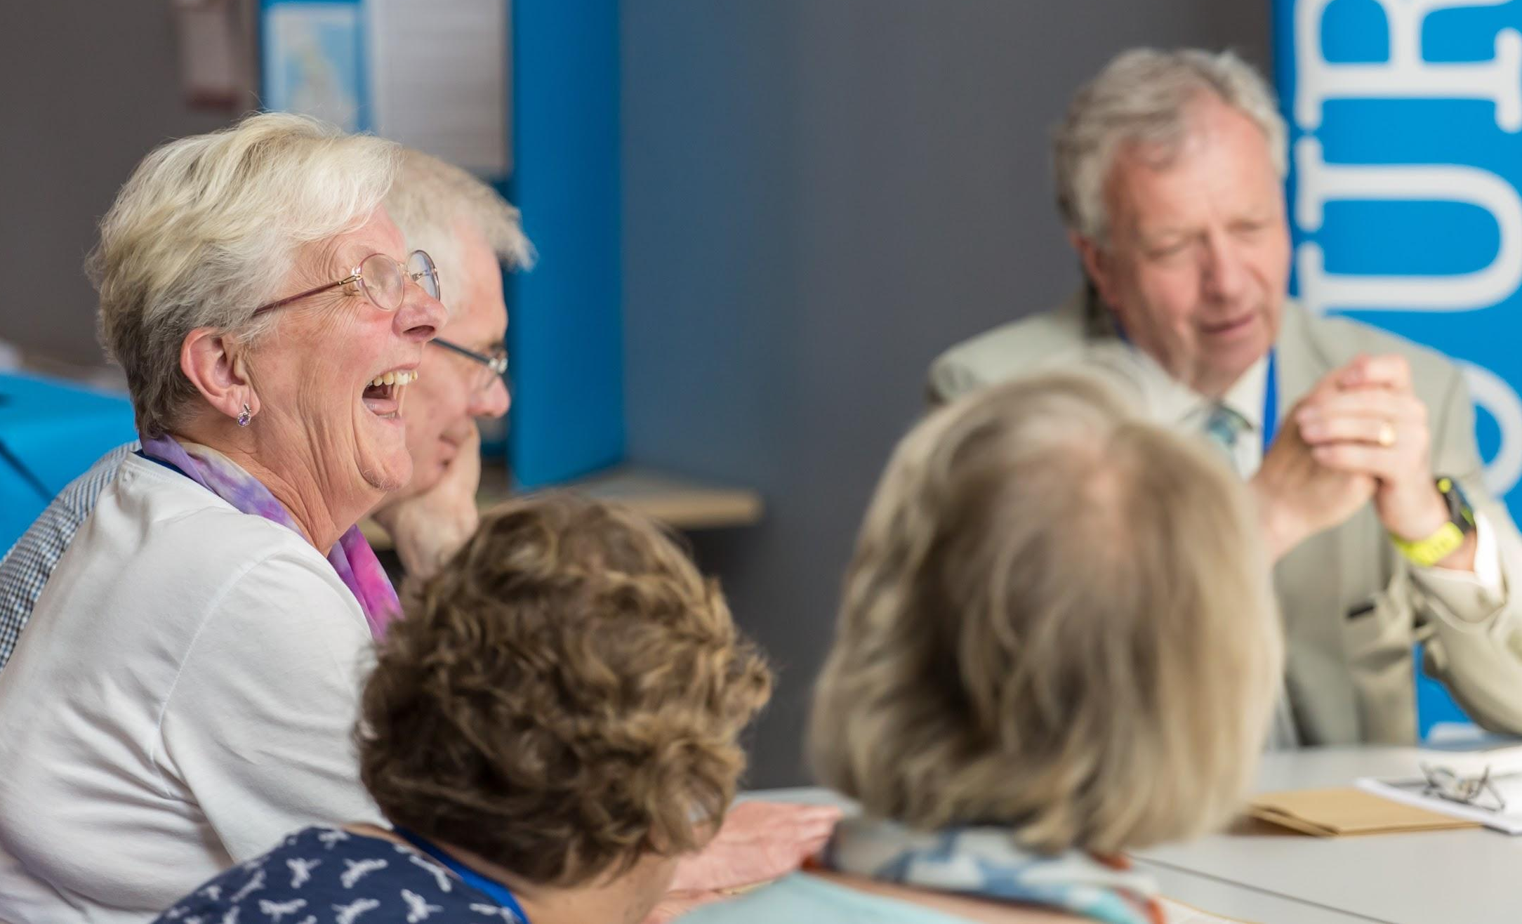
Build a service - The Team
How will you build your team?
Where will you look for volunteers?
Who is going to lead your team?
Will people have set roles depending on skills and interests?
How will you ensure nobody gets overburdened?
How will you evaluate each other?
Does the Minister need to be involved?
Will there be training?
Safeguarding
Remember you will need to go through the Protection of Vulnerable Groups (PVG) scheme

Slide 19
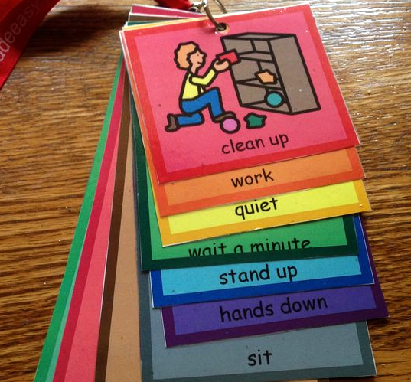
Build a service - Planning the welcome
Does the welcome need to be the same each time?
This can be good for autistic participants or those who need structure and repetition to feel relaxed.
Would pictures help people know what is going on?
Lots of people with learning disabilities have set pictures that they associate with set activities.
What does your building smell like?
This can be a key factor for those with sensory sensitivities.
Does your welcome need to include words and sounds? Is anyone visually impaired?

Slide 20
Build a service - Layout
What kind of layout works best for your group?
Could a more informal seating arrangement help build relationships – like sitting in a circle or in little groups?
Do you always need to face the front? Could you face an interesting window or sit around an interesting object?
Could you bring in really comfortable seating like sofas or bean bags?
Is there extra space between seats for those with mobility aids or for those who like more space?
Where is best to sit in terms of lighting and sound?
Someone who is visually impaired may need bright light.

Slide 21

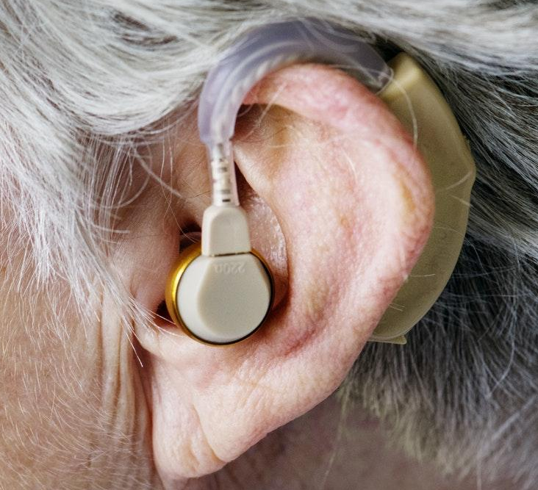
Build a service - Accessibility
How can you make your service more accessible?
Are there disabled toilets?
Some users with profound learning disabilities need a changing room with bed and hoist for toileting.
What technology will help your group?
A loop system, Augmentative and Alternative Communication (AAC) devices, big response buttons, or responsive rolling mat.
Do you need large print, braille, or someone to do British Sign Language?
Will you have to think about feeding equipment or complex dietary needs?

Slide 22
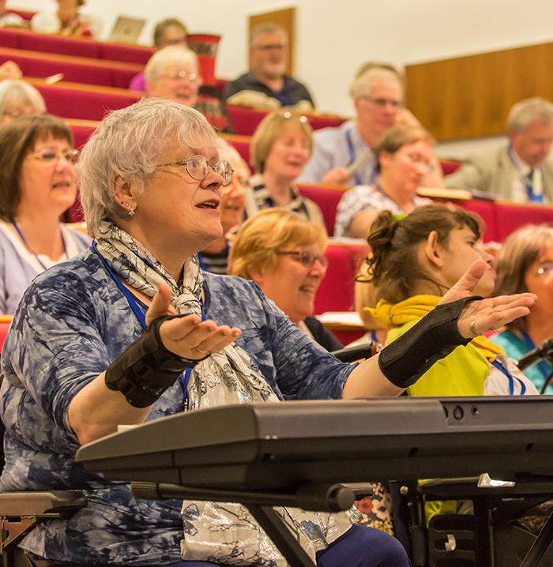
Build a service - Activities
What activities fit best with your group?
Craft, music making, singing, drama, puppets, Bible stories, talks, gardening?
How will you tailor those activities to the abilities of the individuals?
Ask what people enjoy - we all have our preferences.
Have you considered sensory activities? Could you incorporate lots of doing and feeling, different smells or use of lights?
What kind of music would suit your group?
Background music, group singing, movement to music, sensory aids that use lights and vibrations, instruments to play.

Slide 23
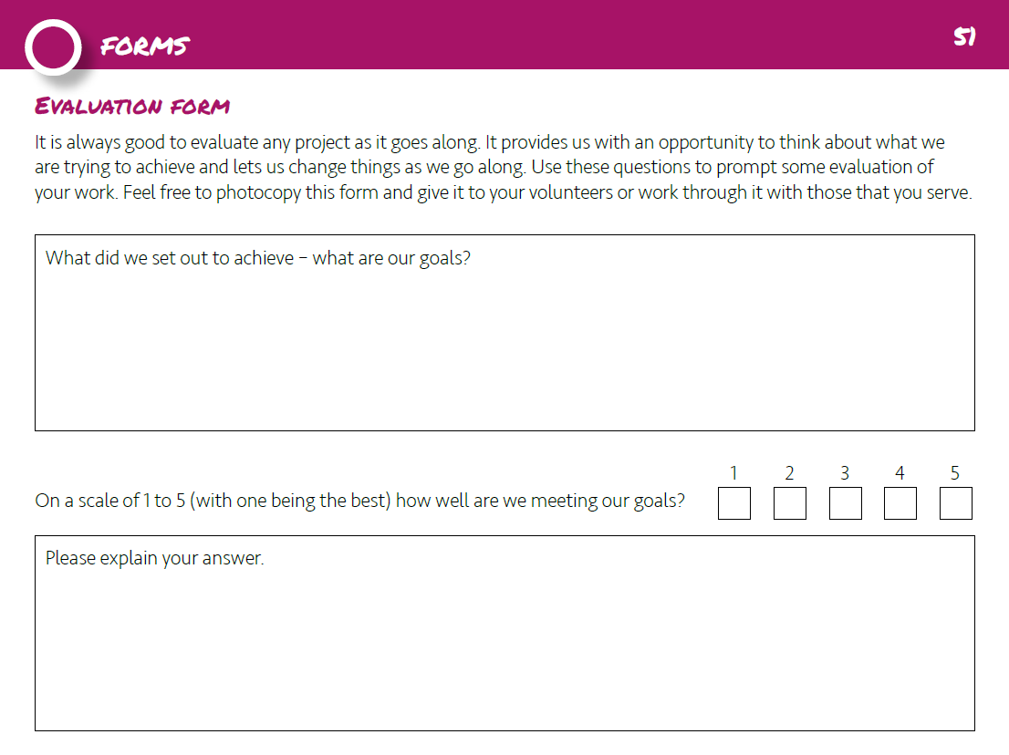
Build a service - Teaching
Will there be a teaching element to your service?
Consider the form your teaching could take - personal testimony, storytelling, Bible based, drama, film, audio.
How will you pitch it at the right level? And how will you evaluate that?
Remember there's a team evaluation form in the Learning Disabilities Action Pack.

Slide 24
Build a service - Personal Conclusions
Think about your own church. What questions has this session provoked in you?
What three small changes could you make in your church to encourage inclusion and move towards a community of belonging?
Are you feeling called to begin conversations on this topic? Who will you talk to first? Name four people.

Slide 25
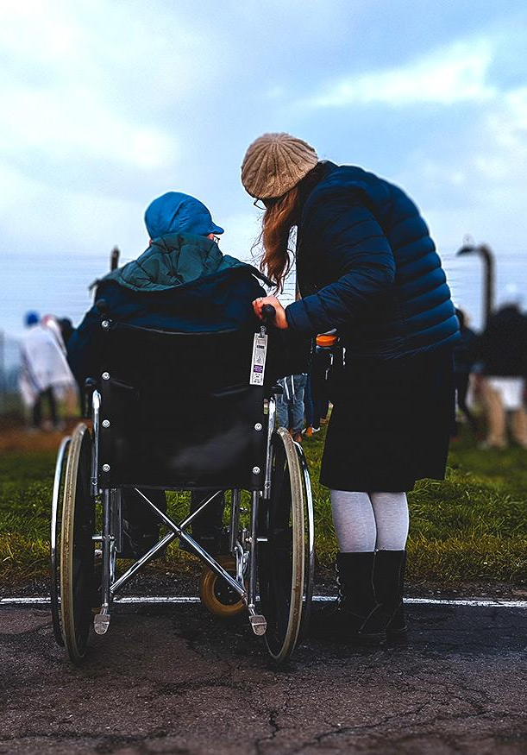
Learning Disabilities
top tips for congregations
In the first instance, please just be friendly to me – smile at me and speak to me.
Please could you invite me to go with you to a church event?
I would love to help in the church. Is there a job you think I could do?
It would be great if you could arrange to meet me sometimes outside church.
Please ask me what my needs are and also ask my carer, but ask me first. Please talk to my carer about their needs as well.
It would be helpful if I had a ‘buddy’ in the church.

Slide 26
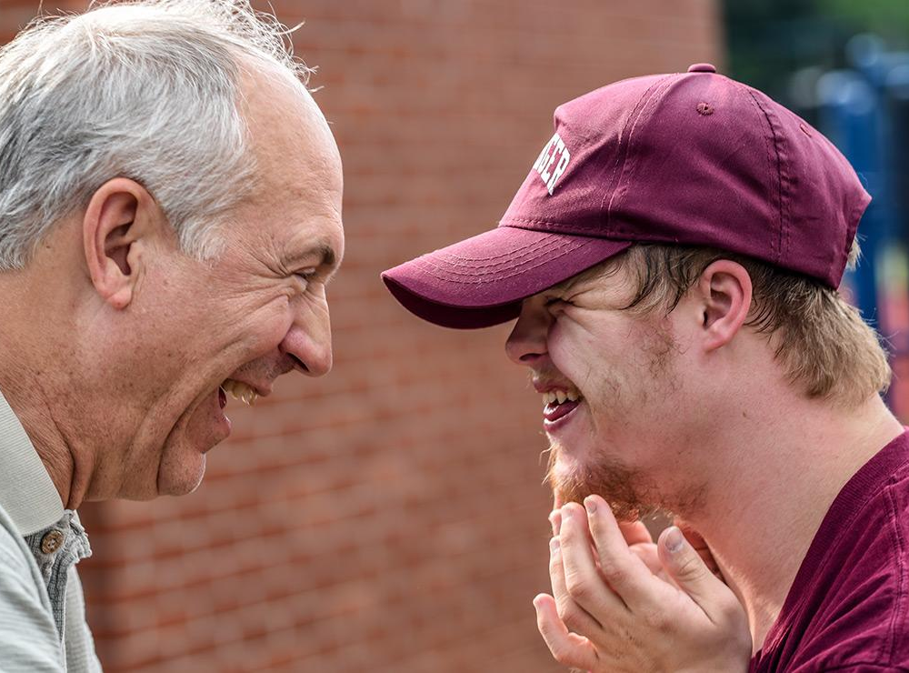
Learning Disabilities
top tips for congregations
The use of standard icons on a screen can help me to know what is happening next.
There are many different technological aids available. Please ask what I use out of church and explore the possibilities of use in church.
Please invite me to share my gifts, stories and hospitality and not leave me to always be the recipient.
Please pray for me – and not just about my disability. I will likely be seeking prayer for the same sort of issues as face us all.

Slide 27
Resources
Livability
Livability is a passionate advocate of the local church as a powerful agent for change. They provide a wide range of training, tools and resources that support churches.
The Happiness Course, Dementia Friendly Church and Ability Sunday are all resources that Livability provides to churches and community groups across the UK.
Explore Livability’s resources
Discussion Starter
Learning Disabilities: a discussion starter is a free learning and development resource for those in our congregations seeking to enable those with learning disabilities to meaningfully belong to their church community.
It is designed to generate discussion and can be used flexibly within group settings or for study by individuals.
Read a copy on our website
-
Through The Roof
Roofbreakers share a common heart to enrich church life by being a ‘bridge’ – enabling disabled people to belong and contribute to church, and helping church to be blessed by the full involvement of disabled people.
They can provide a free starter kit and a connection to a local Roofbreaker network.
Learn more about Roofbreakers
-

